Slide 1
Data Structures (DS)
Week – 03
Sep 14-18, 2020
Instructor: Basit Ali
Email: Basit.jasani@nu.edu.pk
Data Structures (CS-201)

Slide 2
Recursive Thinking
Recursion splits a problem:
Into one or more simpler versions of itself
The General Approach
if problem is “small enough”
solve it directly
else
break into one or more smaller subproblems
solve each subproblem recursively
combine results into solution to whole problem

Slide 3
General Recursive Design Strategy
Identify the base case(s) (for direct solution)
Devise a problem splitting strategy
Subproblems must be smaller
Subproblems must work towards a base case
Devise a solution combining strategy

Slide 4
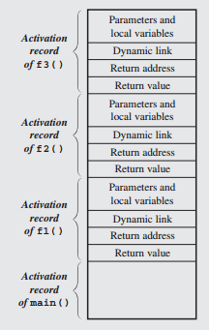
Activation Records

Slide 5
Example
public static int factorial (int n)
{
if (n == 0) // or: throw exc. if < 0
return 1;
else
return n * factorial(n-1);
}

Slide 6
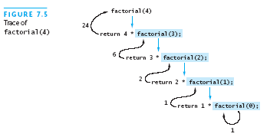
Example

Slide 7
Recursion Versus Iteration
Recursion and iteration are similar
Iteration:
Loop repetition test determines whether to exit
Recursion:
Condition tests for a base case
Can always write iterative solution to a problem solved recursively, but:
Recursive code often simpler than iterative
Thus easier to write, read, and debug

Slide 8
Efficiency of Recursion
Recursive method often slower than iterative; why?
Overhead for loop repetition smaller than
Overhead for call and return
If easier to develop algorithm using recursion,
Then code it as a recursive method:
Software engineering benefit probably outweighs ...
Reduction in efficiency
Don’t “optimize” prematurely!

Slide 9
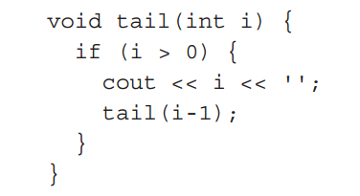
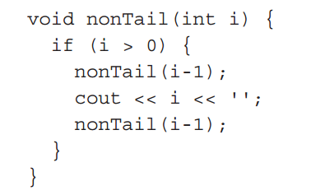
Tail & Non-tail Recursion

Slide 10
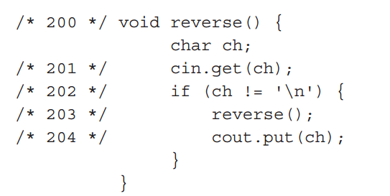
Non-tail Recursion

Slide 11
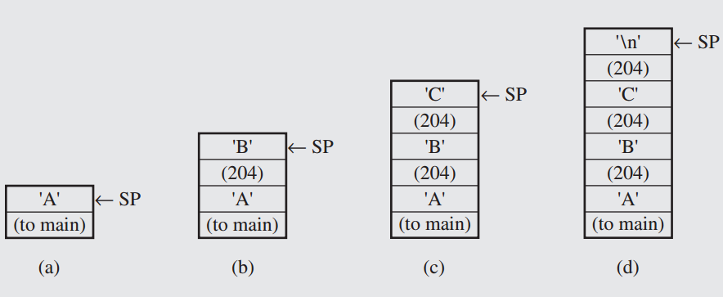
Non-tail Recursion Stack

Slide 12
Indirect Recursion
f() -> f1() -> f2() -> ... -> fn() -> f()
f() -> g1() -> g2() -> ... -> gm() -> f()

